Slide 1

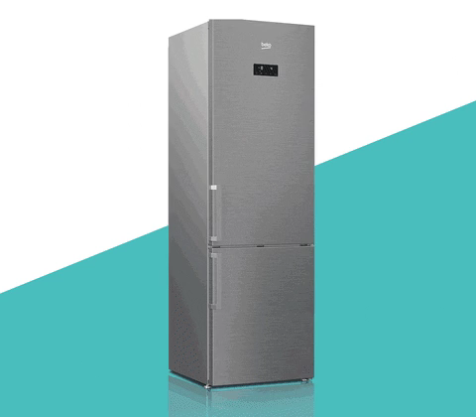
Smart Refrigerator system
Submitted by:-
Trupti B. Deore [BE19S04F001]
Rushikesh K. Gunjal [BE19S04F005]
Pooja B. Thorat [BE19S04F009]

Slide 2
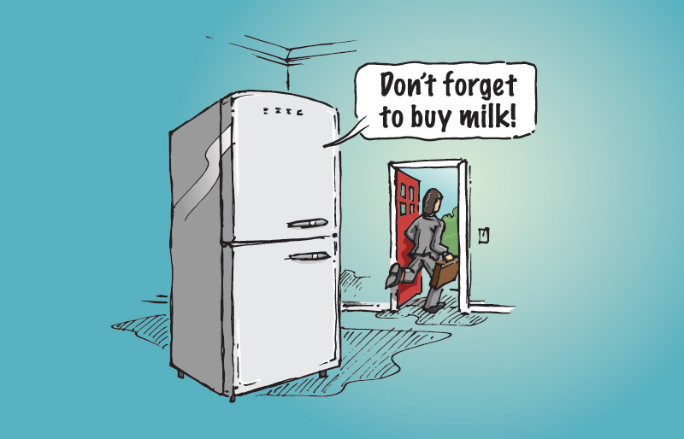
Contents
Introduction
Literature review
Features of system
Hardware block diagram
Circuit diagram
Flowchart
Specification
Advantages
Cost Estimation
Reference

Slide 3
Introduction
In this modern human being is used to deal with technology or we can say it as IOT.
The IOT revolves around an increased trend of machine-to-machine communication. Its core philosophy is built on cloud computing and networks of sensors gathering data.
Recently, smart kitchen always comes to mind whenever we talk about the IOT or also known as Cloud of Things. The reason is the kitchen is the largest producer of waste and second largest user of energy in the home. As we look around ourselves technology, like cell phones, kitchen, appliances and many more. Here we think about smart refrigerator, because people are very busy in day to day life style
Refrigerator is the most frequently used domiciliary/kitchen electrical appliance all over the world for food storage.
Principally this appliance is used for various tenacities like storing vegetables, fruits etc. Smart refrigeration module is designed to convert any existing normal refrigerator into a smart and low cost machine using sensors. Smart refrigerator compares the status of the food for e.g. weight, quantity , quality etc. and also informs user.

Slide 4
Literature review
Nikhil Kakade, Prof. (Dr.) S. D. Lokhande,has proposed a system,” IoT based Intelligent home using Smart Devices” that sense the daily needs of particular items in the refrigerator and automatically places an order to the grocery shop.
Deepti Singh, Preet Jain , has proposed the system “Smart Refrigerator” which can sense the weight of the food items placed in the refrigerator and sends a notification to the user’s mobile through an application when the weight falls below the threshold value.
Poonam B. Patil, Roopali R. Patil, Swati V. Patil has proposed a system “Home Automation System using Android and Arduino Board” which implements the methodology of using mobile application to control the home appliances remotely. It uses GSM modem to transmit the data to mobile.

Slide 5
Literature review
4. Mukesh P et al, has proposed a system,” Smart Refrigerator using IoT” In which they provided the communication with outsiders.
5.Hasin-Han Wu, has proposed a system, “Low-Cost Smart Refrigerator”, it describes the overall design of a low-cost Smart Refrigerator built with Raspberry Pi. Next, it has two sensors controlling each camera, which are hooked up to the Raspberry Pi board.
6.Ramesh, J. Lingaiah has proposed the system,” Raspberry Pi Based Interactive Home Automation System through E-Mail”. This system uses Email rather than Bluetooth to send notification to user as it is not efficient. It also uses LEDs to indicate switching action.

Slide 6
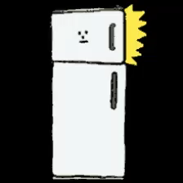
Features of system
Remotely notify the user and control the functions inside the refrigerator.
Set expiration dates and receive notifications to use food while it's fresh.
Send alert SMS when the Ingredient are near to finish.
Give alarm
You can send and received SMS from anywhere
Low cost
Internet connectivity
Requires 5v DC

Slide 7
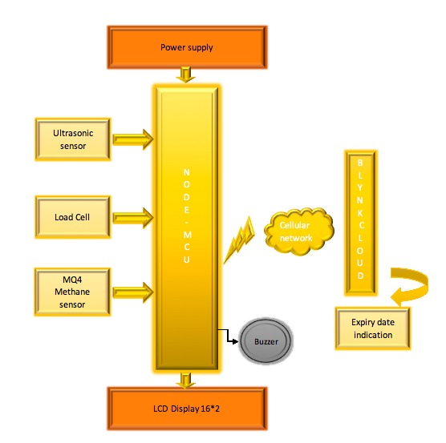
Hardware block diagram

Slide 8
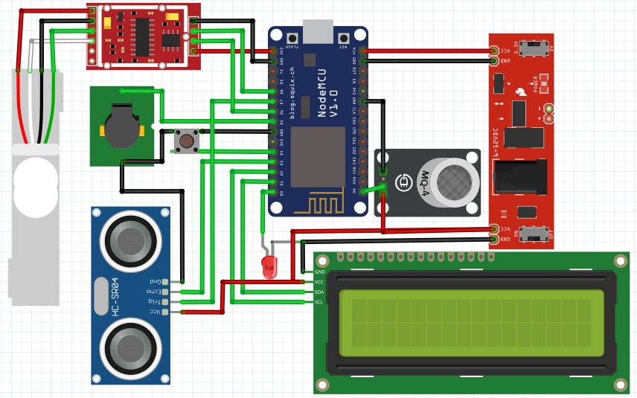
Circuit diagram

Slide 10
Flowchart

Slide 11
Specification
Fully interactive system with 2-3 different working can communicate through internet
A low cost affordable small size module feasible for any type of refrigerator
Various applications such as milk level monitoring, Freshness and quantity checking, Grocery management, etc.
A full functional android app having reminder of expired products with grocery/shopping list
System has Low voltage with less power consumption works on DC so not harmful for user

Slide 12

Advantages
No need of extra efforts
It can monitor available food
Send SMS to user when food is near to finish
Gives alert of product expiration
Check quality of vegetables
Low cost
Easy to design

Slide 13

Gantt Chart
 | March |  |  |  | April |  |  |  | May
 | Week 01 | Week 02 | Week 03 | Week 04 | Week 01 | Week 02 | Week 03 | Week 04 | Week 01 | Week 02 | Week 03 | Week 04
Market Research
Specifications
Planning
Design/Code
Development
Training
Assessment
Documentation
4 march
19 march
31 march/ 7april
17-25 april
3 may
12-18may
20 may
22 may…
Pooja
Rushikesh
Trupti

Slide 14
Cost Estimation
Components | Price
ESP 8266 | 270/-
ULTRASONIC SENSOR | 75/-
LOAD CELL 6kg | 425/-
HX711 | 95/-
LCD 16*2 | 110/-
BUZZER | 35/-
POWER SUPPLY 5V/1A | 90/-
CONNECTING WIRES | 35/-
MISCELLANEOUS | 120/-
TOTAL COST | 1316/-

Slide 15
Reference

Slide 17
Reference
http://www.ijlera.com/papers/v2-i3/part-II/31.201703127.pdf
https://www.ijariit.com/manuscripts/v3i1/V3I1-1375.pdf
Https://www.irjet.net/archives/V7/i3/IRJET-V7I31041.pdf
http://www.ijrar.com/upload_issue/ijrar_issue_20543710.pdf
https://www.youtube.com/watch?v=cv0yKRALZpI
https://ieeexplore.ieee.org/abstract/document/8535867/

